Slide 1

What’s in Your Food?
A Data-Driven Nutrient Analysis
By Alina Yildir
Please read more at https://medium.com/@yildir.a.mdsa/whats-in-your-food-a-data-driven-nutrient-analysis-e3a0f7a5c553.

Slide 2
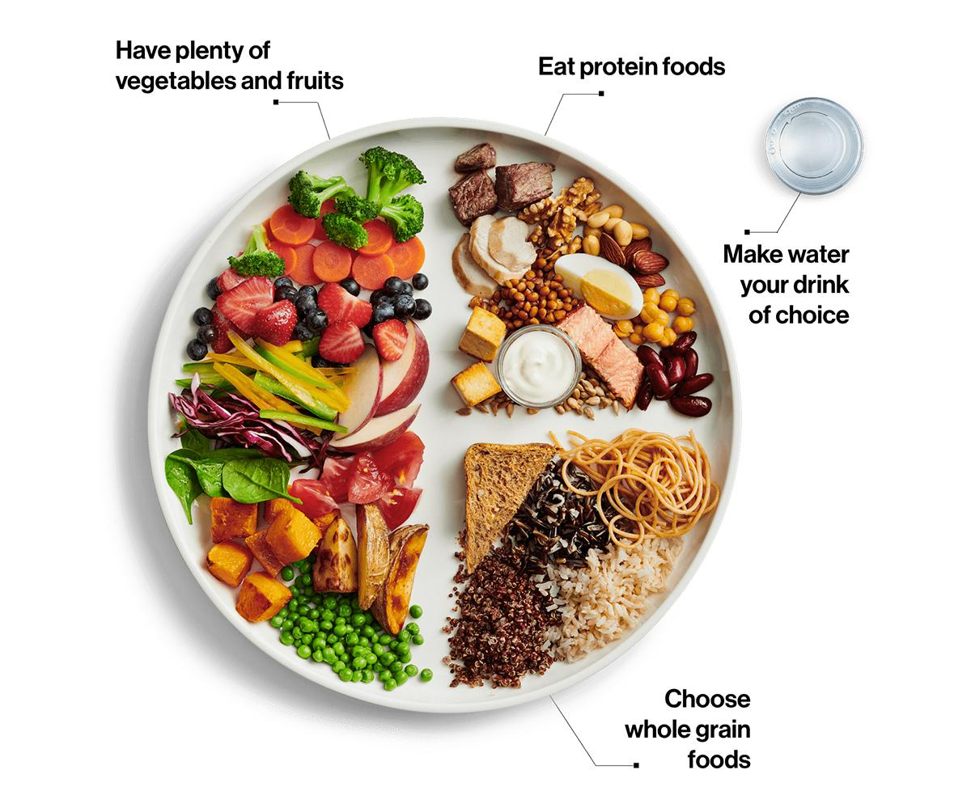
Introduction
According to Canada’s Food Guide, maintaining a balance of nutrients such as protein, fibre, carbohydrates, and potassium contributes to better overall health. At the same time, reducing the intake of saturated fat, trans fat, sugar, sodium, and cholesterol plays a key role in minimizing health risks.
Image source: Canada’s Food Guide, Government of Canada. Retrieved from https://food-guide.canada.ca/en/.

Slide 3
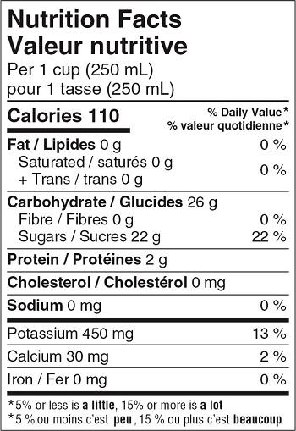
Objectives
The objective is to analyze food categories, subcategories, and individual foods to identify the highest and lowest levels of the 12 key nutrients from the Nutrition Facts Table, compare protein-to-fat ratios across subcategories, and evaluate nutrient density per calorie for macronutrients (carbohydrates, protein, and fat).
Image source: Nutrition Facts Tables, Government of Canada. Retrieved from https://www.canada.ca/en/health-canada/services/food-nutrition/nutrition-labelling/nutrition-facts-tables.html.

Slide 4

Data Preprocessing
Dataset: The Canadian Nutrient File (Health Canada) – provides nutrient data for 1,000+ commonly consumed foods, covering 19 nutrients.
Original Format: 17 separate CSV files (one per food category).
Preprocessing Steps (applied to each file individually):
Removed unnamed rows/columns containing only missing values.
Flattened multi-level headers while preserving relevant subheadings.
Selected 12 key nutrients based on Nutrition Facts Table guidelines.
Standardized column names to align with Health Canada’s format.
Replaced "tr" (trace amounts) and "N/A" (no suitable value available) with 0.
Added the missing + Trans (g) column where necessary.
Retained only relevant columns and reordered them for consistency.
Normalized nutrient values to be per 100g instead of per serving size for standardization.
Final Merged Dataset: 1,098 foods, 30 columns (Food Name, Calories, Fat, Carbohydrates, Protein, Sodium, Iron, etc.).
Please read more at https://github.com/yildiramdsa/nutrient_composition_of_common_foods_in_canada_analyzing_the_canadian_nutrient_file/blob/main/notebooks/data_preprocessing.ipynb.

Slide 5
Question 1. Which food categories contain the highest and lowest levels of the 12 key nutrients listed in the Nutrition Facts Table?
Question 2. Within a selected food category, which subcategories have the highest and lowest levels of these nutrients?
Question 3. Within a selected subcategory, which individual foods have the highest and lowest levels of these nutrients?
Question 4. Which food subcategories have the highest and lowest protein-to-fat ratios?
Question 5. Which food subcategories have the highest nutrient density per calorie, particularly for macronutrients (carbohydrates, protein, and fat)?
https://public.tableau.com/app/profile/alina.yildir/viz/AData-DrivenNutrientAnalysis/AData-DrivenNutrientAnalysis2
https://public.tableau.com/app/profile/alina.yildir/viz/AData-DrivenNutrientAnalysisPerServing/AData-DrivenNutrientAnalysis
https://yildiramdsa-nutrient-composition--csv-chatbotcsv-chatbot-kdmzcd.streamlit.app

Slide 6

1
2
Which food subcategories have the highest nutrient density per calorie, particularly for macronutrients (carbohydrates, protein, and fat)?
df['Protein per Calorie'] = df['Protein (g)'] / df['Calories']
df['Fat per Calorie'] = df['Fat (g)'] / df['Calories']
df['Carbohydrate per Calorie'] = df['Carbohydrates (g)'] / df['Calories']
nutrient_density = df[['Food Subcategory', 'Protein per Calorie', 'Fat per Calorie', 'Carbohydrate per Calorie']].groupby('Food Subcategory').mean().reset_index()
4
3
Food Subcategory Protein per Calorie Fat per Calorie Carbohydrate per Calorie
Baked Goods 0.0151 0.0151 0.0957
Beverages 0.0039 0.0039 0.0788
Fish 0.0254 0.0187 0.0021
Nuts 0.0148 0.0448 0.0059
Vegetables 0.0093 0.0032 0.0853
Food subcategories with the highest nutrient density per calorie, particularly for macronutrients, are:
Carbohydrates: Vegetables and Fruit subcategories provide high carbohydrate content, primarily from dietary fibre and natural sugars, with relatively low-calorie counts, making them nutrient-dense options.
Protein: Fish, Shellfish, and Poultry and Game Birds subcategories deliver high protein with fewer calories, making them excellent choices for protein-dense foods.
Fat: Nuts, Nut Butters, and Seeds subcategories offer high levels of healthy fats, along with essential nutrients, while maintaining a balanced calorie-to-nutrient ratio.

Slide 7

Summary
Identified food categories with the highest and lowest levels of 12 key nutrients.
Analyzed subcategories within each food category to determine nutrient variation.
Examined individual foods within subcategories to highlight the most and least nutrient-dense options.
Compared food subcategories based on protein-to-fat ratios.
Evaluated nutrient density per calorie for macronutrients (carbohydrates, protein, and fat).

Slide 8

References
Government of Canada. (n.d.). Canada’s food guide. Retrieved from https://food-guide.canada.ca/en/.
Government of Canada. (n.d.). Nutrition facts tables. Retrieved from https://www.canada.ca/en/health-canada/services/food-nutrition/nutrition-labelling/nutrition-facts-tables.html.
Government of Canada. (n.d.). Canadian nutrient file. Retrieved from https://open.canada.ca/data/en/dataset/a289fd54-060c-4a96-9fcf-b1c6e706426f.

Slide 9

Thank You for Your Attention!
Please read more at https://medium.com/@yildir.a.mdsa/whats-in-your-food-a-data-driven-nutrient-analysis-e3a0f7a5c553.

